Slide 1
ENGI 301 Record Player Alarm Clock PCB Proposal
November 11 2021
Hugo Estrada II

Slide 2
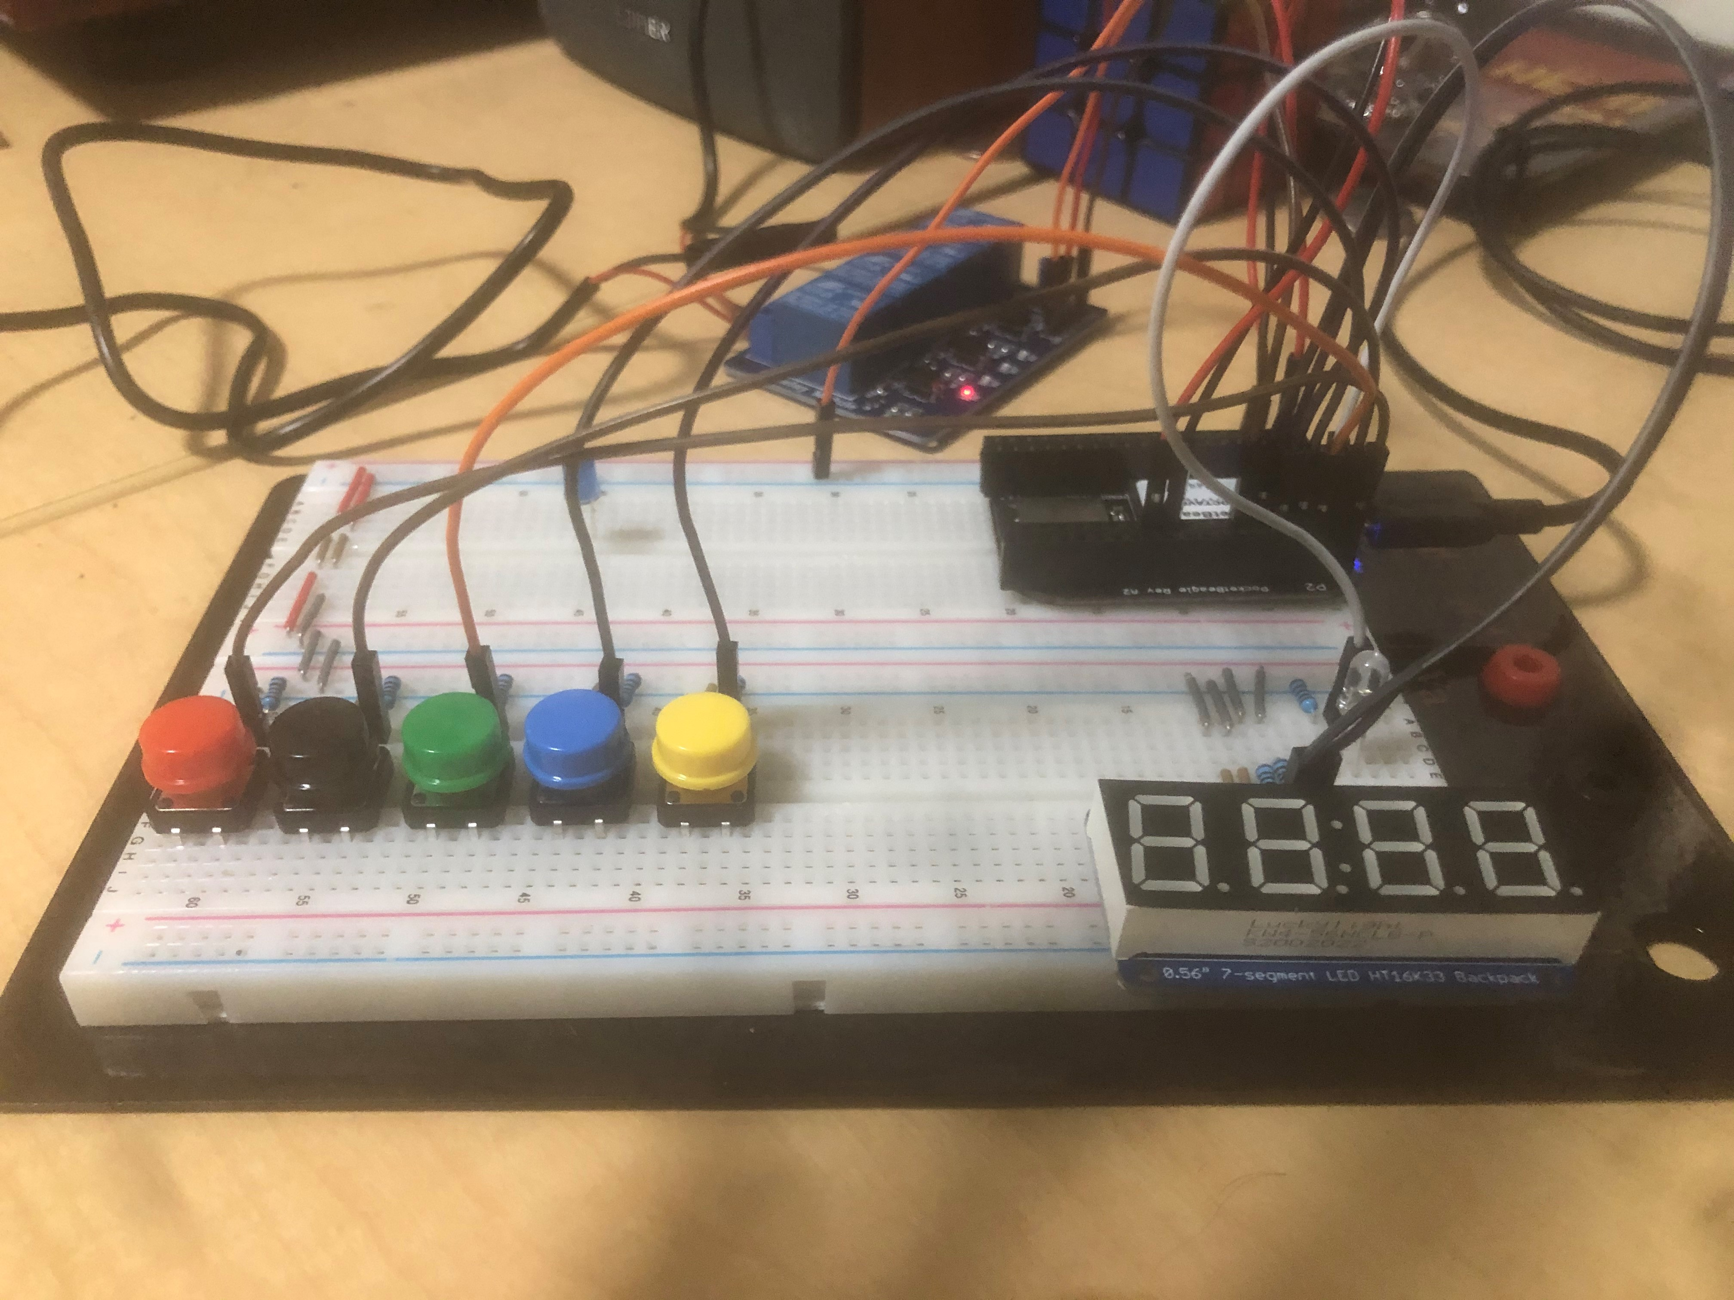
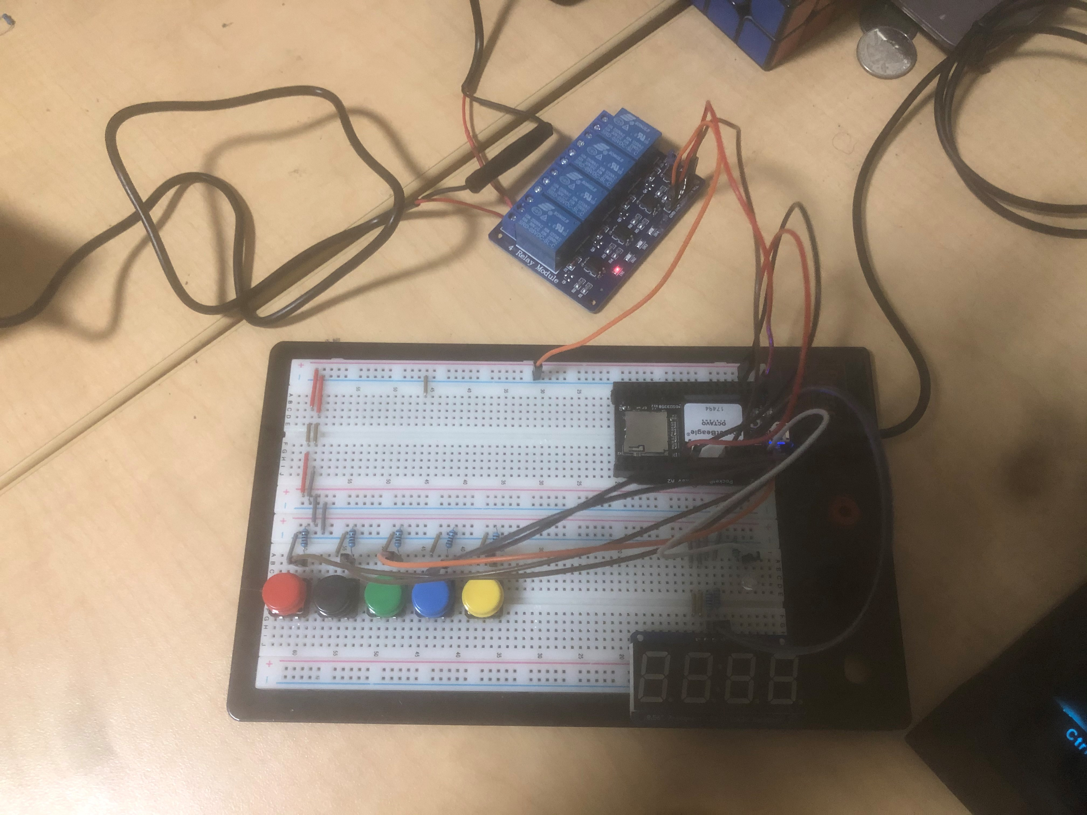
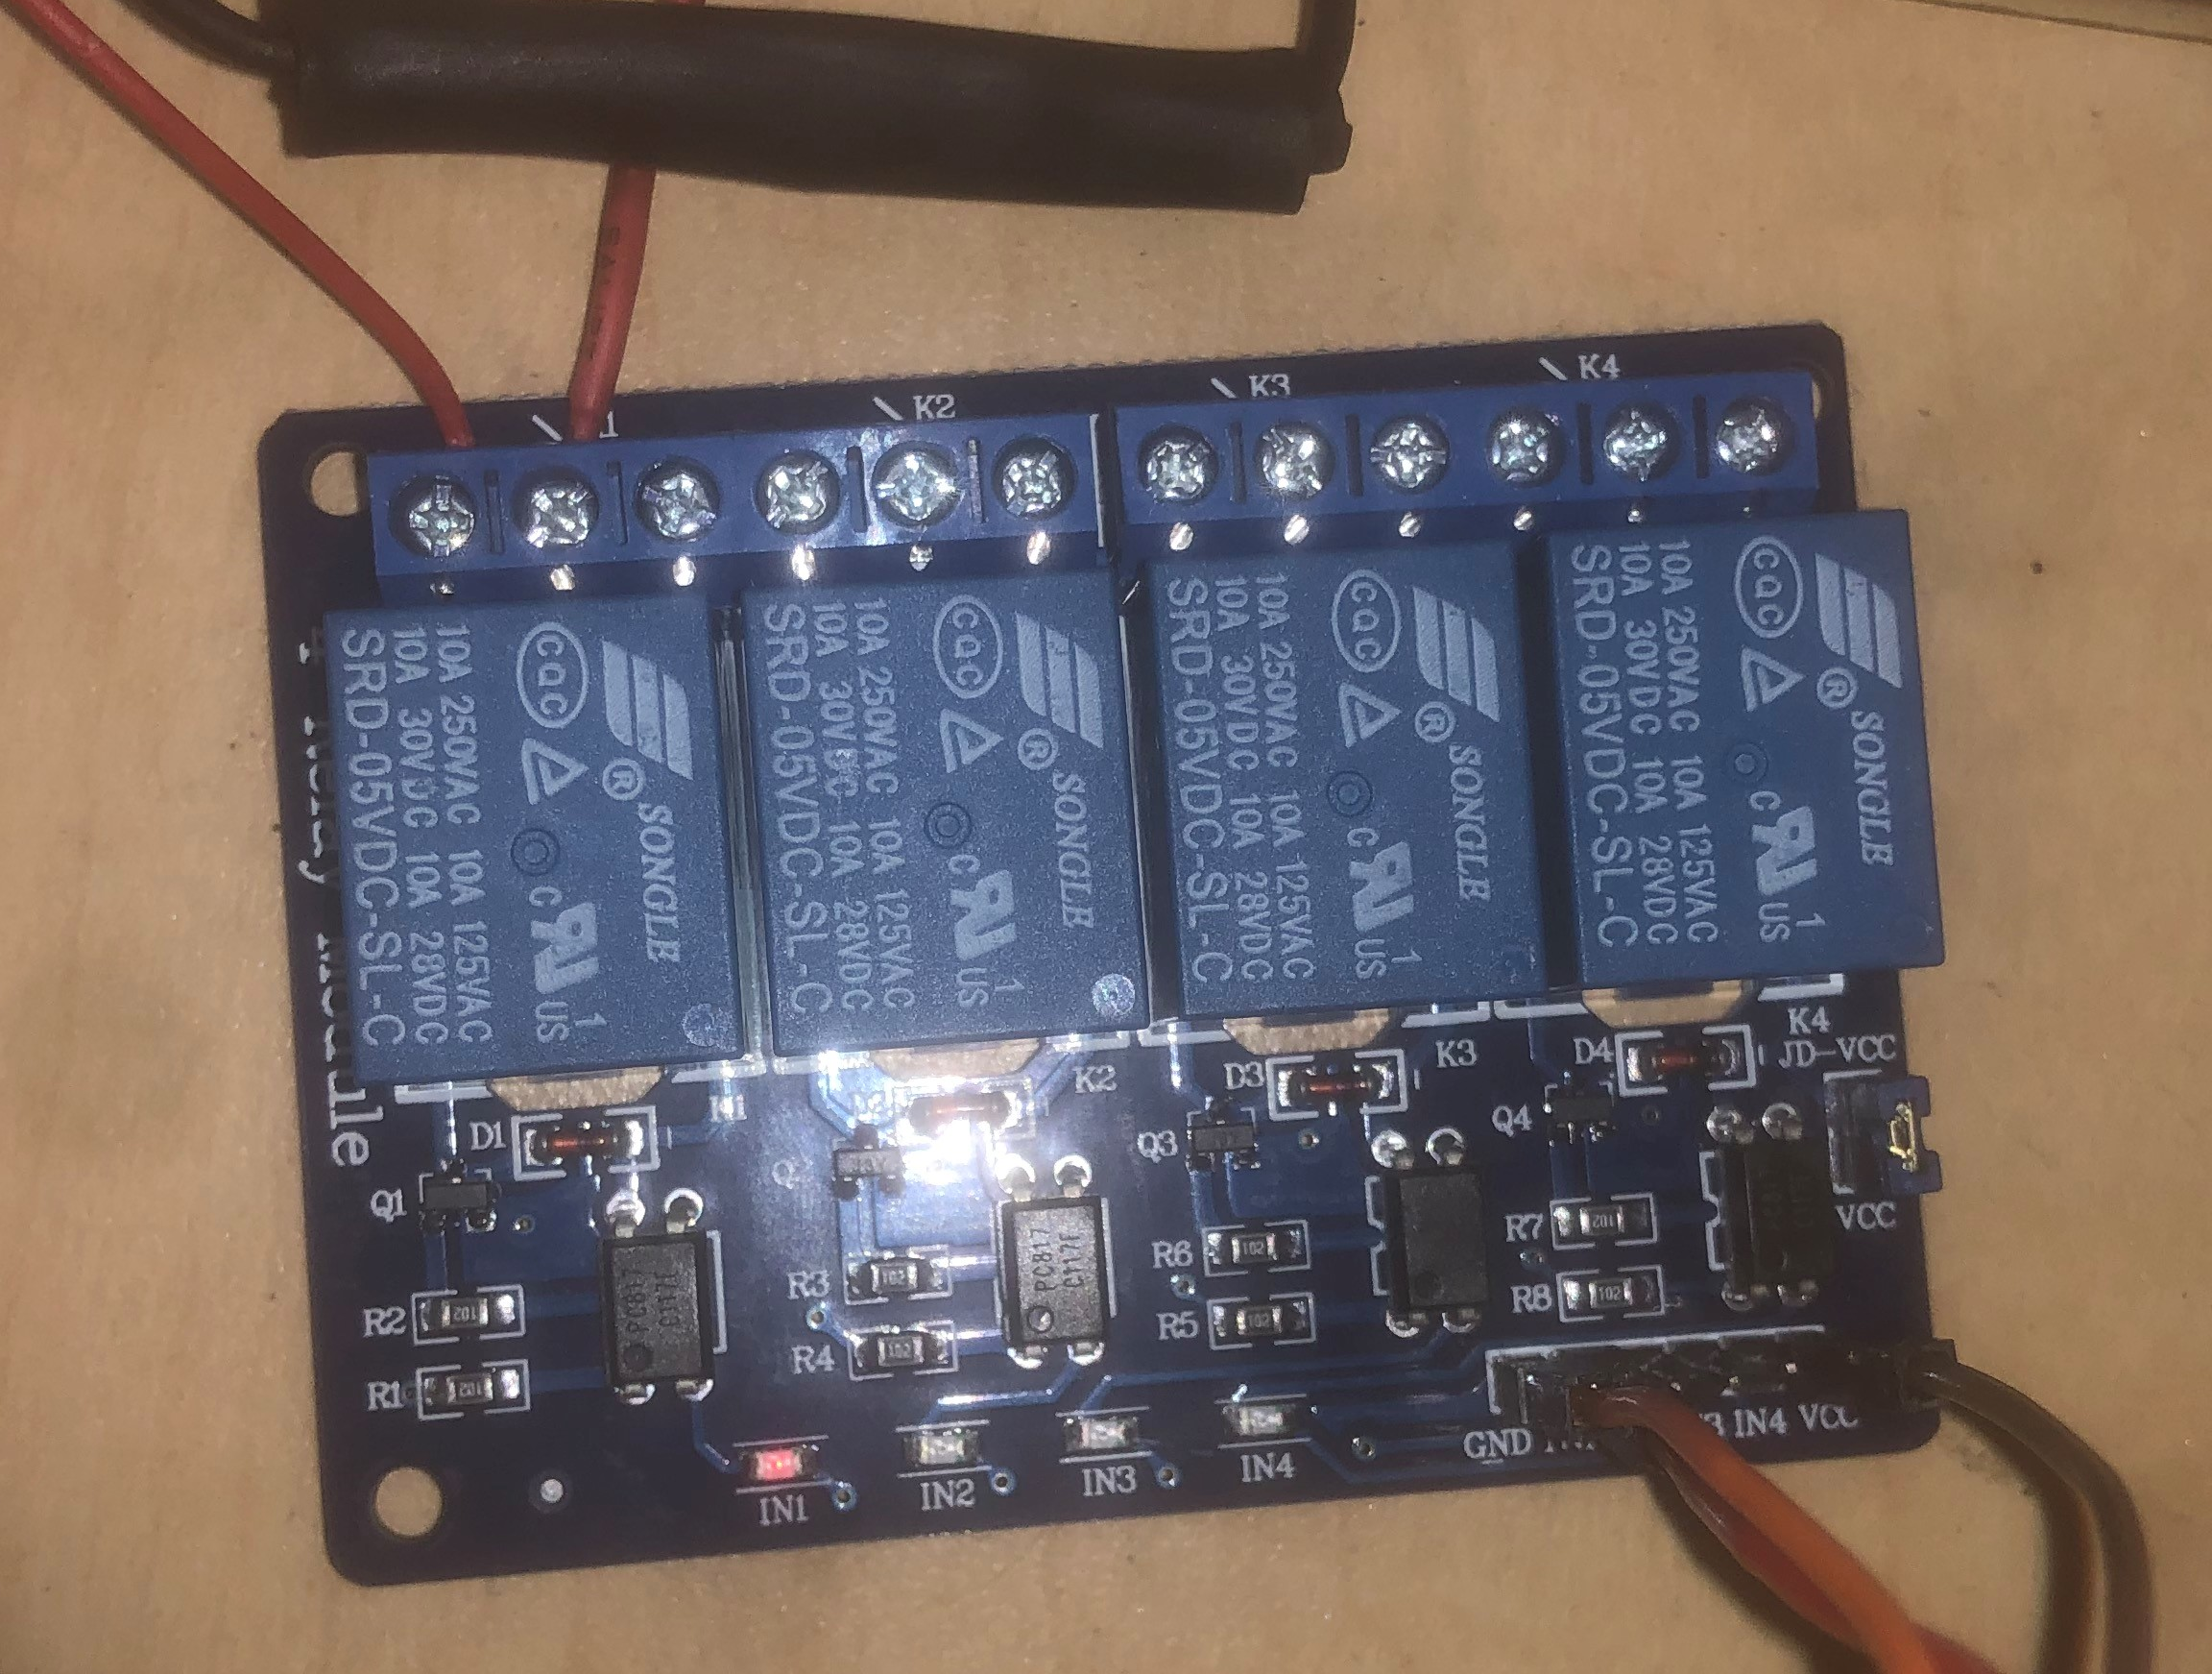
Background Information
What is being proposed?
GitHub: https://github.com/hugoestradaii/ENGI301/tree/main/python/project_01
Hackster.io: https://www.hackster.io/hugoestradaii/record-player-alarm-clock-121bae
What changes (if any) are you going to make based on your prototype?
Make Prototype User Friendly
12-hour time with LED for AM/PM
Be Able to Change Alarm Time Easier
Create a physical shell to make the device seem nicer

Slide 3
System Block Diagram
Hex Display
P
Wall Power
SCL
C
VOUT
Pocket Beagle
N
GND
SDA
D
Buttons
Pos
GPIO
Relay
GPIO
Neg
GND
VOUT
GND
GND
GPIO
Pos
Record Player
Neg
LEDs

Slide 4
Mechanical Block Diagram
5”
.25”
Hex Display
.5”
Pocket Beagle
3”
USB
Button
Button
Button
Button
Button
Relay
2.5”
FRONT
BACK

Slide 5
Components Required
Create a list of all the components that you require for the PCB
7 Segment Hex Display
5xButtons
2xLEDs
1x5V Relay

